Slide 1
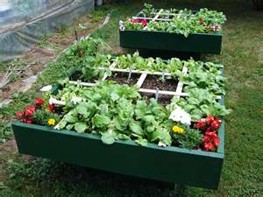
Square Foot Gardening
Notes:
Talking about Square Foot Gardening and how you are not limited to the 4x4 size and also lasagna gardening.

Slide 2
Square Foot Gardening
It is a method of gardening where you plant your vegetables in a 1’x1’ square
Advantages of Doing this:
  Reduced Weeding
    The close plant spacing suppresses the weeds
  Reduced Maintenance
    Bad Back? No Problem
    No tilling or turning
  Improved Aeration of the Soil
    Without any foot traffic on the actual bed, the soil is not compressed and the root structure of the plants are free to grow
  Protection from Inclement Weather & Animals
    Protection with the use of floating row covers, plastic and bird netting
Notes:
Sun won’t easily get to the soil meaning the weed seeds won’t germinate as easily.

Slide 3
Planning Your Garden
Size
  Square Foot Gardens are 4x4
      You can make it out of wood, bricks, or blocks
      If using lumber do not use treated wood. The chemicals may leach into the garden
  You are not limited in the size
      Just make sure that the middle of the bed is within arm reach.
Notes:
Railroad Ties-make sure they are older ones where the creosote has leached out already.

Slide 4
Location, Location, Location
Use the following to determine where to put your garden
  Place it close to the house or where you will walk by it
  Pick an area that gets 6 to 8 hours of sunshine daily
  Stay clear of trees and shrubs
  The area should not puddle after a downpour
  Place it near a water source

Slide 5
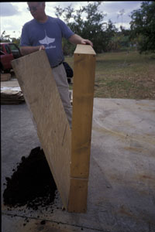
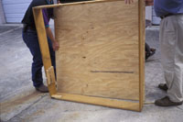
BOXES
Build boxes to hold a new soil mix or compost above ground.
Use a solid base on concrete; use newspaper or cardboard as a base on grass or soil.
Box sides should be:
4 feet x 6 inches

Slide 6
Building the 4x4 Square Foot Garden
Boxes
If using lumber:
  Materials Needed
    (4) 4-foot 2x6 inch boards
    (6) 4-foot long twine or wood slats
    Soil
    Wood Screws
    Power Drill
    Seeds/Plants
Notes:
2x6” boards come in 8’ lengths. You can have HD or Lowes cut the boards into 4’ pieces.

Slide 7
Building the Square Foot Garden Box
Preparation
  Pre-drill 3 holes in one end of each board
Assembly
  Screw 3 large deck screws through the pre-drilled holes, attaching the boards, end-to-end, until you have a complete frame
  Once assembled, move the box to your chosen location
  Lay down newspaper or cardboard and fill box with either 100% compost or equal parts coarse vermiculite, peat moss & compost
  Place your twine or wood slats so that it makes (16) 12”x12” squares

Slide 8
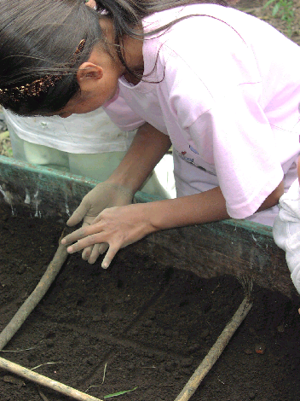
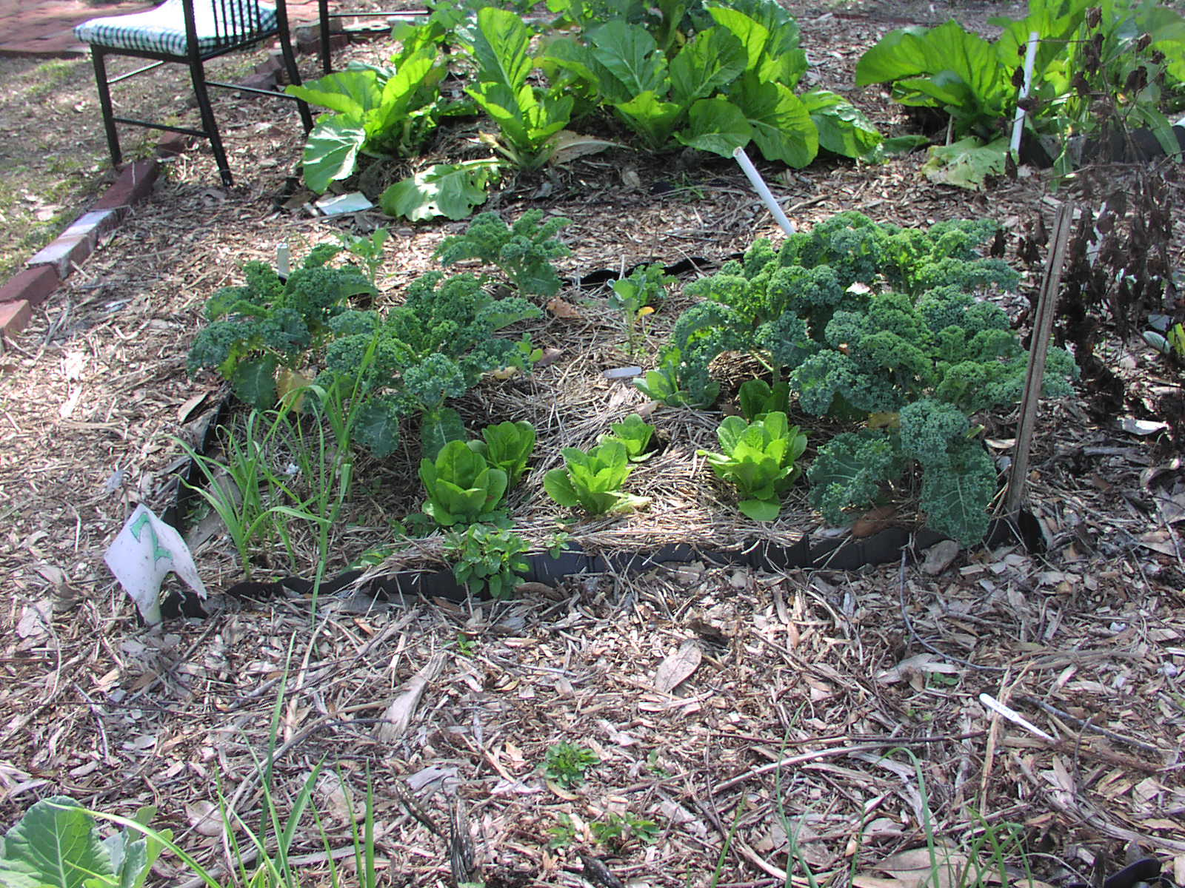
PLANT
Plant a different flower, vegetable,
or herb crop in each square, using 1, 4, 9, or 16 plants per square, as
appropriate.

Slide 9
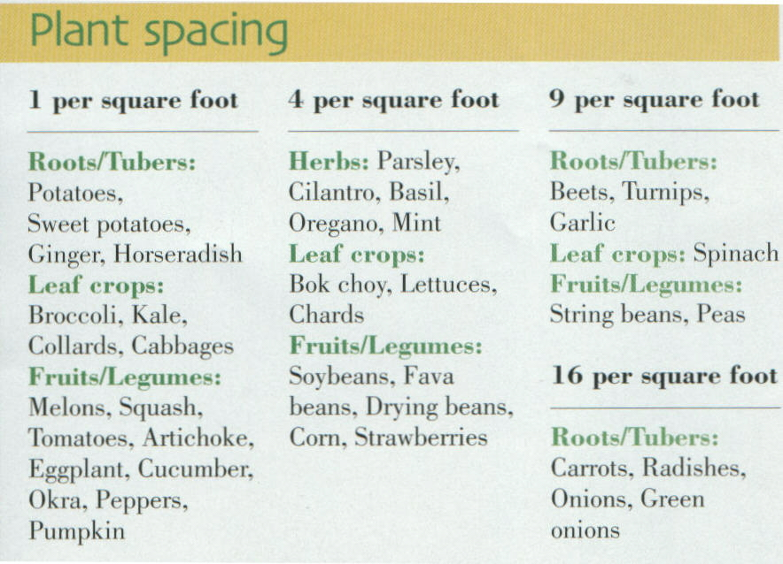

Slide 10
How Do You Plant a Square Foot Garden
Spring, Summer and Fall

Slide 11
What to Consider Before Planting
Determine where North is or watch how the sun moves through the sky
Determine which is your tallest and shortest plants
Determine the growth habit of the plant

Slide 12
The Spring Garden

Slide 13

S
P
R
I
N
G
G
A
R
D
E
N
 | 8 PEAS IN EACH SQUARE FOOT
 |  | USE A TRELLIS TO TRAIN THE PEAS TO GO UP ON

Slide 14
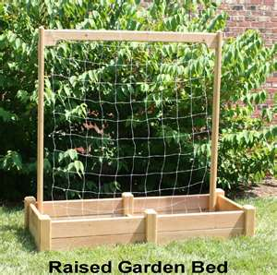
Trellis

Slide 15
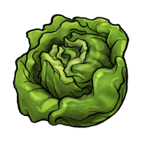
S
P
R
I
N
G
G
A
R
D
E
N
 | 4 LETTUCES IN EACH SQUARE FOOT

Slide 16

S
P
R
I
N
G
G
A
R
D
E
N
 | 4 PARSLEY PLANTS PER SQUARE FOOT

Slide 17

S
P
R
I
N
G
G
A
R
D
E
N
9 BEETS PER SQUARE FOOT

Slide 18

S
P
R
I
N
G
G
A
R
D
E
N
 | 16 CARROTS PER SQUARE FOOT

Slide 19

S
P
R
I
N
G
G
A
R
D
E
N
16 RED RADISHES PER SQUARE

Slide 20

S
P
R
I
N
G
G
A
R
D
E
N
 | 16 WHITE RADISHES PER SQUARE

Slide 21

S
P
R
I
N
G
G
A
R
D
E
N
163 Plants
4 SWISS CHARD PER SQUARE

Slide 22
The Summer Garden

Slide 23

SUMMER GARDEN
 |  | 1 Tomato PER SQUARE

Slide 24

SUMMER GARDEN
1 BASIL PLANT PER SQUARE

Slide 25

SUMMER GARDEN
 | 1 OKRA PER SQUARE

Slide 26

SUMMER GARDEN
 | 1 PEPPER PLANT PER SQUARE

Slide 27

SUMMER GARDEN
IT SAYS YOU CAN PLANT 9 GREEN BEANS PER SQUARE, BUT I SUGGEST JUST DOING 6 PER SQUARE

Slide 28

SUMMER GARDEN
2 PER SQUARE. IF YOU ARE USING VINING CUCUMBERS INSTEAD OF BUSH, TRAIN IT TO GO UP THE TRELLIS THAT THE PEAS WERE ON

Slide 29

SUMMER GARDEN
 | 1 SUMMER SQUASH PER SQUARE

Slide 30

SUMMER GARDEN 36 Plants
1 LARGE MARIGOLD PLANT PER SQUARE OF 4 SMALL MARIGOLD PLANTS PER SQUARE

Slide 31
The Fall Garden

Slide 32
S
P
R
I
N
G
G
A
R
D
E
N
FALL GARDEN CAN LOOK THE SAME AS YOUR SPRING GARDEN OR

Slide 33







FALL GARDEN 52 Plants

Slide 34
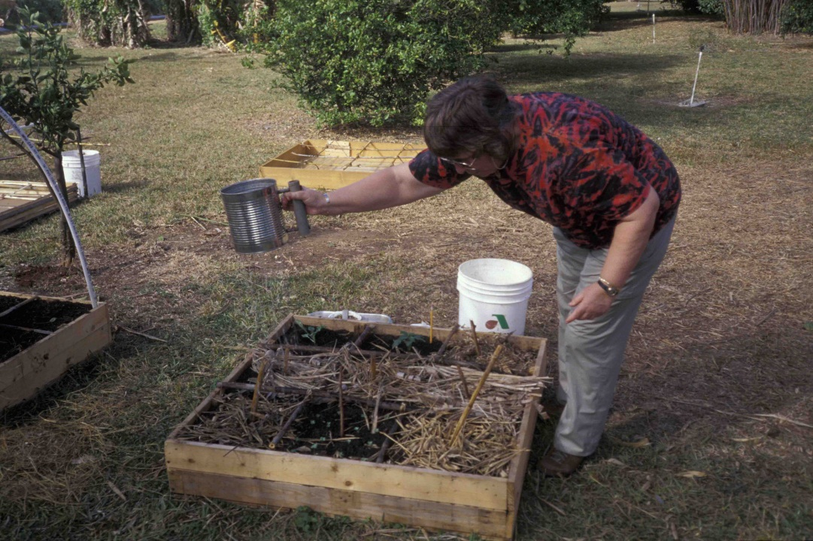
CARE
NEVER WALK ON
YOUR GROWING
SOIL.
Tend your garden from
the aisles.

Slide 35
Different Types of Raised Beds

Slide 36
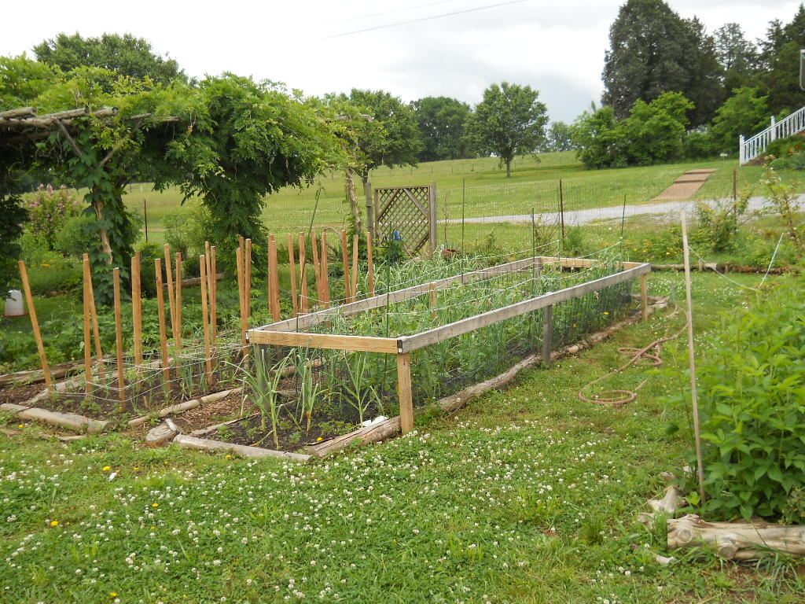
Cedar Trees

Slide 37
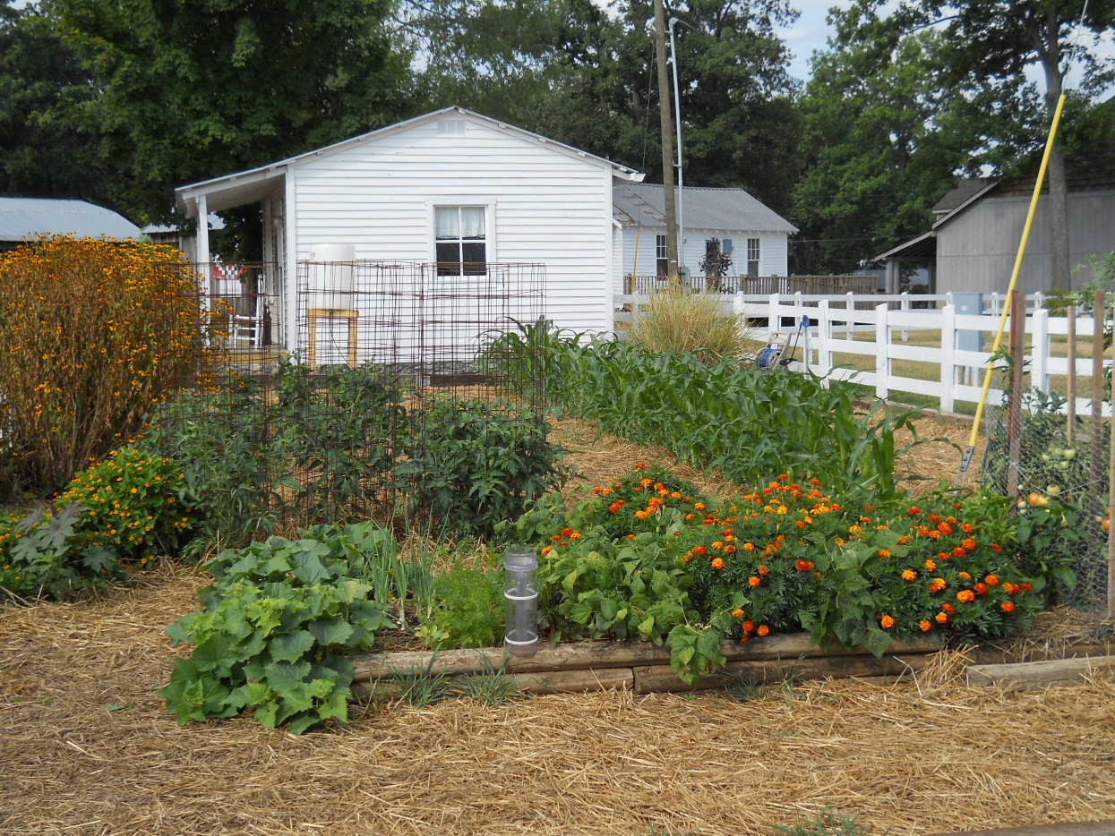

Slide 38
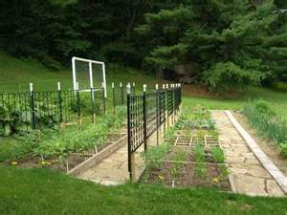
You Can Be As Fancy

Slide 39
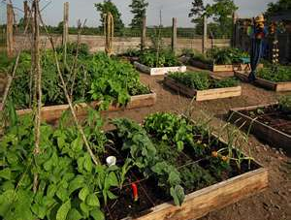
Or As Simple As You Want

Slide 40
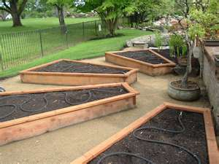
You Are Not Limited to the 4x4 Box
Notes:
Your are not limited to the 4x4 box.

Slide 41
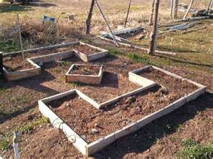
Any Shape You Want
It just depends on how handy you are with a hammer and saw
And how much space you have

Slide 42
Example of 12”x12” Grid
Notes:
Notice the 1’x1’ grid

Slide 43
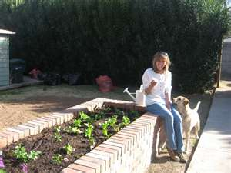
Bad Back Friendly

Slide 44
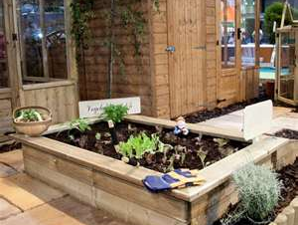

Slide 45
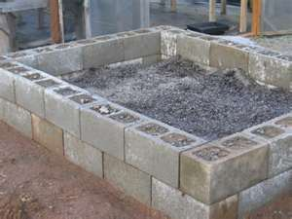
Blocks
Use the holes in the blocks to plant lettuce or flowers.

Slide 46
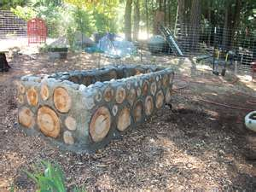
Logs Held in Place with Cement

Slide 47
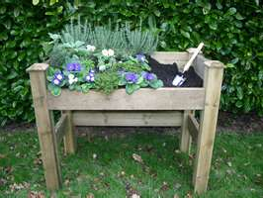
Wheelchair Friendly

Slide 48
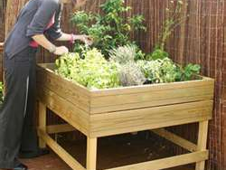
You can still have a garden even though you don’t have a yard

Slide 49
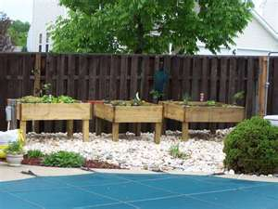

Slide 50
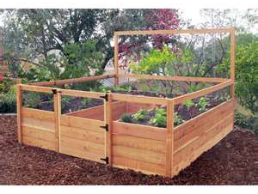

Slide 51
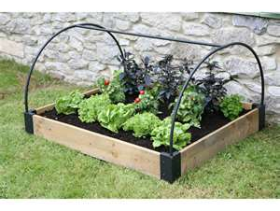
Frost and Animal Protection
You can use plastic for frost protection or bird netting to protect from animals.

Slide 52
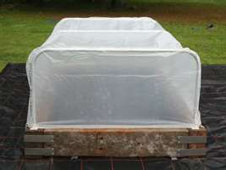
Protection From Frost

Slide 53
Questions

