Slide 1
FALL GARDENING
WHAT TO PLANT
AND
HOW TO EXTEND YOUR SEASON
Presented by
Marianne Pelletier, CMG
Wilson County Master Gardeners Assoc.

Slide 2
Plant a Garden in Fall???
You can’t grow anything in the fall.
You can only have fresh vegetables from the garden in the spring and summer
Harvest vegetables in November??? No way!!!

Slide 3
What’s the Secret?
Know your first frost date
October 29th
Chose crops that thrive in the cooler temperature
Carrots, Radish, Lettuce, Broccoli & Cauliflower
Chose ones with shorter growing seasons
  They’ll germinate, take root & produce before winter weather sets in
Choose varieties that do best in the fall.

Slide 4
      Leafy Vegetables (direct seed)
        Matures between 40-60 days
        They get sweeter after a few light frosts
      Brassicas (transplants)
        Matures between 60-80 days
        Tolerates cold nights & frosts
      Root Vegetables (direct seed)

Slide 5
What are the advantages?

Slide 6
Advantages
The garden is already prepared. Just add some compost before planting.
Soil temperatures
  Soil is already warm so there’s no shock to new plants & seeds
Weeds
  Once you pull them they don’t come back as quickly as they would in spring or summer
Pests
  Planting late allows you to grow vegetables out of sync with the insects’ life cycles

Slide 7
What can you plant now?

Slide 8
July 1-Aug 1
Cucumber (Pickling)(50-55 days to harvest)
  Variety
    Country Fair
    Pickalot
    Saladin
    Carolina
Cucumber (Slicing)(50-65 days to harvest)
  Variety
    Sweet Slice
    Burpless
    Sweet Success
    Marketmore

Slide 9
July 1-Aug 1
Potatoes (Irish)(90-100 days to Harvest)
  Variety
    Cobbler
    Kennebec
    Yukon Gold
    Red Pontiac
Tomatoes (70-80 Days to Harvest)
  Variety
    Betterboy
    Celebrity
    Long Keeper
    Sweet Million
    Lemon Boy
    Pink Girl

Slide 10
July 1-Sept 1
Collards (65-75 days to harvest)
  Variety
    Blue Max
    Georgia
    Vates
Kale (55-65 days to harvest)
  Variety
    Vates
    Dwarf Blue
    Curled Vates

Slide 11
July 1-Sept 15
Lettuce (Leaf) (40-50 days to harvest)
  Variety
    Salad Bowl
    Oakleaf
    Black Seeded Simpson
    Red Sails
July 5-Aug 15
  Cabbage (60-75 days to harvest)
    Variety
      Round green types
      Red Rookie
      Gourmet
      Stonehead
      Savoy King

Slide 12
July 15-Aug 15
Beans, Bush (52-60 days to harvest)
  Variety
    Provider
    Blue Lake
    Top Crop
    Derby
    Roma II
Broccoli (60-70 days to harvest)
  Variety
    Emperor
    Green Comet
    Premium Crop
    Packman

Slide 13
July 15-Aug 15
Cauliflower (55-65 days to harvest)
  Variety
    Snow Crown
Summer Squash (40-50 days to harvest)
  Variety
    Dixie
    Butter Bar
    Early Summer Crookneck

Slide 14
Aug 1-Sept 15
Radish (25-30 days to harvest)
  Variety
    White Icicle
    Cherry Bell
    Champion
Turnip Roots(40-65 days to harvest)
  Variety
    Purple Top
    White Globe
    Tokyo Hybrid
    Just Right
    White Lady

Slide 15
Aug 1-Sept. 30
  Turnip Greens (30-40 days to harvest)
  Variety
    Seven Top
    All Top
Sept 10-Sept 20
  Spinach (40-50 days to harvest)
  Variety
    Longstanding
    Bloomsdale
    Tyee
    Melody

Slide 16
But I Want Fresh Veggies in the Winter

Slide 17
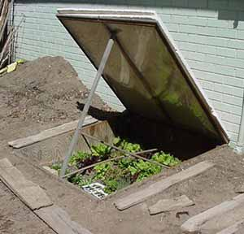
If Using a Cold Frame
Aug 1-Oct 1
  Kale
Aug 1-Sept 15
  Broccoli
  Cauliflower
Aug 1-Oct 1
  Garlic
Sept 1-Nov 1
  Carrots
  Turnips
  Lettuce
  Leeks
Sept 1-Dec 1
  Radish
  Beets
  Spinach
  Onions
  Cabbage
  Peas

Slide 18
When Planting Seed
Maintain Moisture During Germination
  Water soil before planting fall garden
    Increase available moisture
    Reduce crusting
  Plant seeds ¼ inch deeper than you would in spring
    Reduces the chance of seed drying out
  Mulch

Slide 19
Old Man Winter is Coming
How to Protect Your Plants and Extend the Season

Slide 20
Covering Your Crops
A heavyweight row cover can provide an additional 4 to 8 degrees of protection depending on weight of fabric
  Can be draped on top of the plants to protect them
  Or supported by wire hoops
Cold frames can be constructed from wood, concrete blocks or straw bales
  Be sure to add a clear lid of some sort such as old windows or plexiglass
  If temps get really low you can throw a blanket over it
****Ventilation maybe needed during the day for both methods of protection. Temperatures should not go above 65 degrees.

Slide 21
Watering a Cold Frame
Pay close attention to the watering needs of your plants during September & October
  It’s still warm inside the frames which will increase evaporation and will increase the plants’ need for water
November to February the secret to watering cold frames is to do very little and the coldest of those months do none at all
  Evaporation is reduced when the sun is low during the winter months.

Slide 22
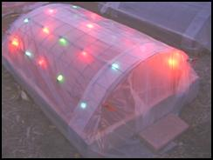
Ways to Extend the Season
Row Covers
With Christmas Lights

Slide 23
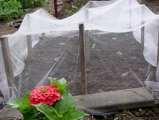
Row Cover

Slide 24
Ways to Extend the Season
Cold Frame

Slide 25
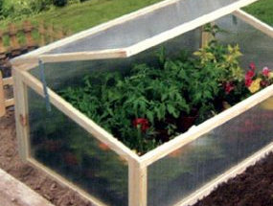
Ways to Extend the Season
Cold Frame

Slide 26
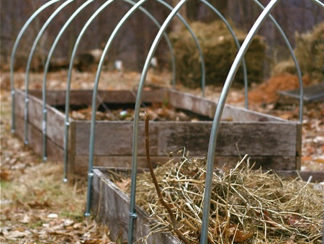
Ways to Extend the Season
Hoop House

Slide 27
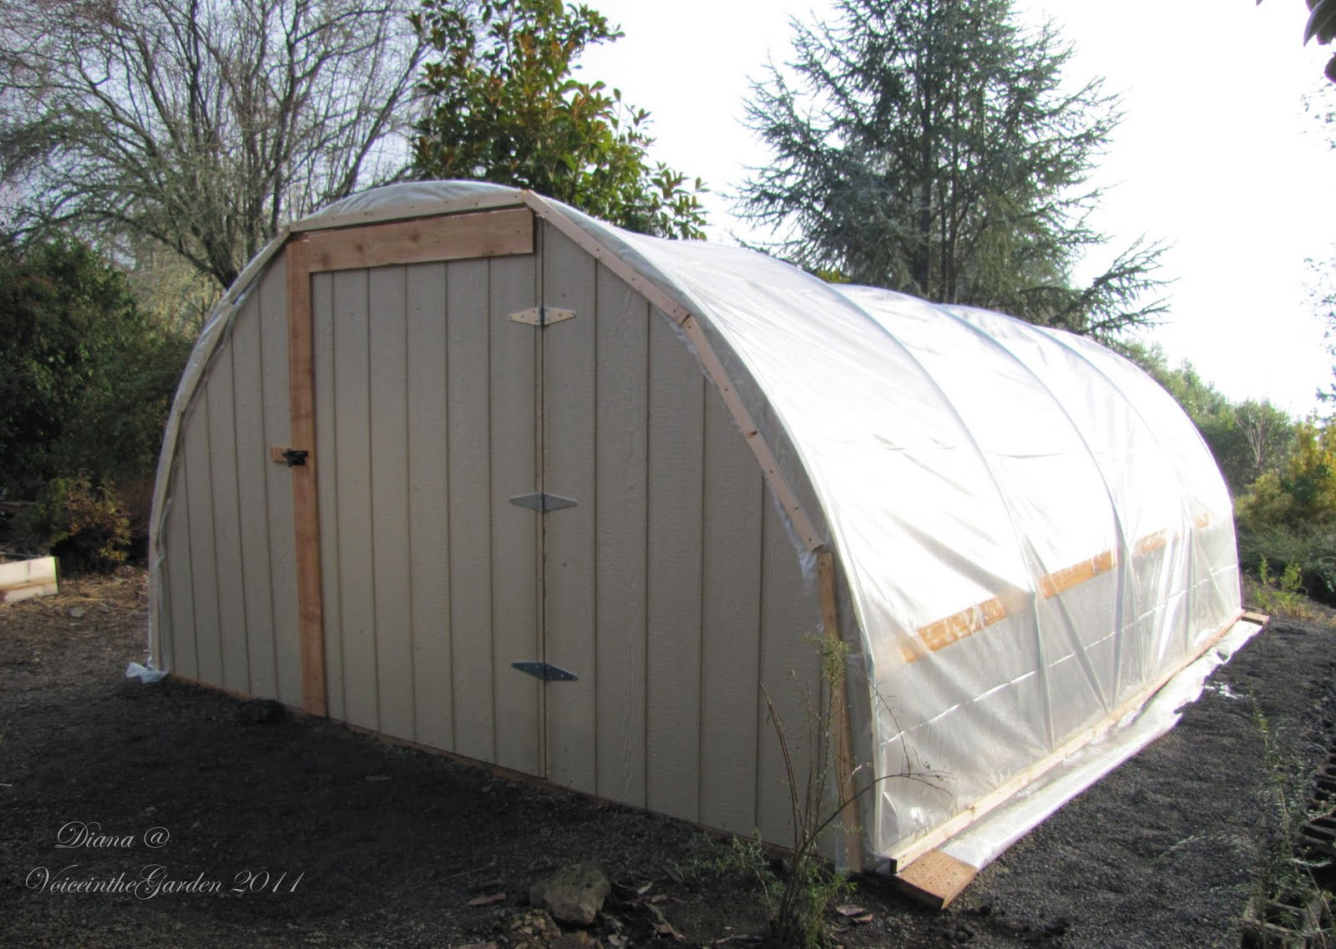
Hoop House

Slide 28
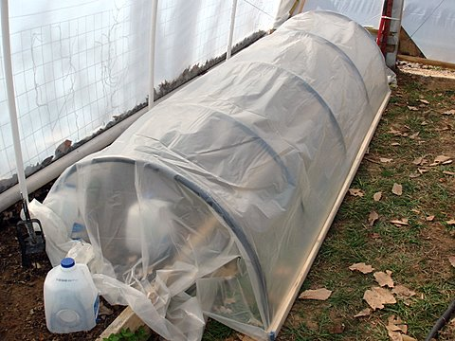
Hoop House within a Hoop House

Slide 29
Any Questions?
HAPPY GARDENING!!

