Slide 1
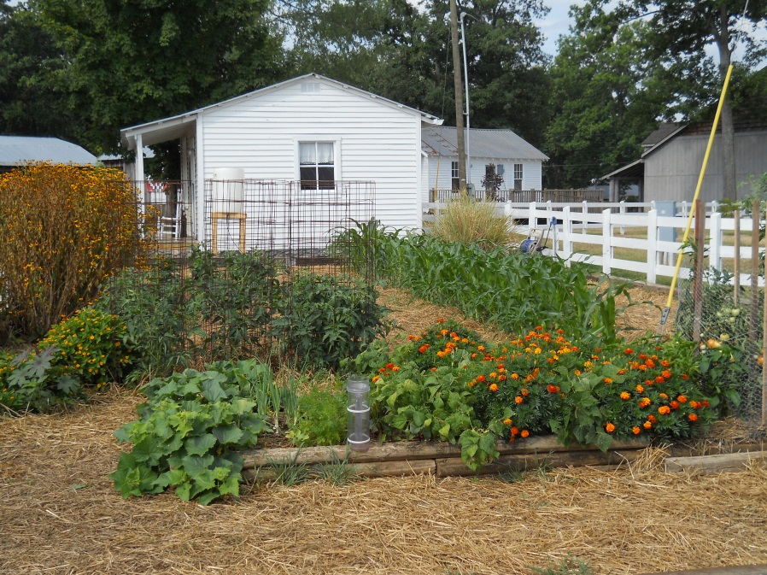
VEGETABLES 101

Slide 2
What’s on the Agenda?
Benefits of Growing Your Own Garden
How to Select a Site
Different Types of Gardens
Site Preparation
Soil Test
Planning
Crop Rotation
What Varieties Do Best in the Area
How to Read a Seed Packet
Fertilization
How to Plant a Seed or Transplant
How to Protect Your Plants
Watering Methods
Pest Management

Slide 3
Benefits of Growing Your Own Vegetables
Improve family health
Save money on groceries
Reduce environmental impact
Provide a reason for outdoor exercise
Enjoy better tasting food
Build self reliance and a sense of pride
Provide a sense of control of food safety

Slide 4
Selecting a Site
Four basic plant requirements to consider
              Soil
                Deep, fertile, well- drained
              Light
                Minimum of 6 hours of daylight
                Don’t put near anything that may cause a shadow
              Space
                Depends upon what you plan to grow
              Water
                Different vegetables require different amounts of water; make sure you are able to supply the adequate amount needed.
You may also want to consider if you need fencing

Slide 5
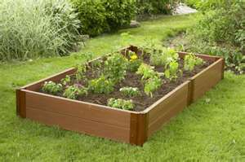
Types of Gardens
Raised Beds
  Grow more in a smaller area
  Drain and warm-up earlier in the spring
  Soil is easier to manage and pests are easier to control
  It’s attractive and appealing in appearance

Slide 6
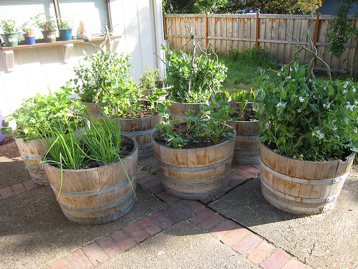
Types of Gardens
Containers
  Great if you have limited space
  Can be on a deck, patio, doorstep or windowsill
  Easily accessible, convenient, space efficient and soil & drainage issues can be controlled
  Be sure to have the container off the ground with pot feet so that you can get better drainage
  Needs to be watered frequently; never let the soil dry out.

Slide 7
Site Preparation
Clean the Area
Mark the area
Remove boards, rock, old plant supports and general debris
Cut or chop weeds and crop residue
    If residue is free of disease and mature weed seed it can be worked into the soil or composted.
If new garden kill and remove plant material
  Soil Solarizing
Add organic material or compost to cleared area

Slide 8

Getting the Soil Ready for Planting
Soil needs to be worked at least 6” deep and smoothed before planting
    You can use a rototiller or a shovel
Seed & transplants should be planted in moist, finely aggregated soil.
    If water can be squeezed from a handful of garden soil or if it does not break apart when dropped, it is too wet
    Soil that is too wet will form clods

Slide 9
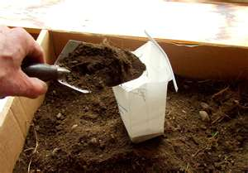
Site Preparation
Soil Test
  Soil sample box and info sheet are available at the Agricultural Extension office
  Use a small trowel or spade to collect samples
  Collect from 8 to 10 locations throughout garden
  Soil should be dry
  Collect top 4 to 6” of soil
  Place soil in a clean plastic bucket and mix
  Do not collect samples from where water stands, heavy amounts of ashes have been dumped or where debris has laid.
  Soil samples should be taken the same general time each year
  Fill the box ¾ full with the thoroughly mixed soil
  Fill out the info sheet and request the basic test
  Mail in or drop off at the Extension Office
  Results will be 2 weeks

Slide 10
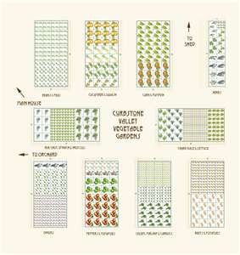
Garden Plan
Saves time, space, work and money
Consider the following
    Which varieties do you like?
    Do you want to extend the harvest season?
    Which varieties should be rotated to a new location?
    Do you want to increase or decrease the amount of harvest?
    Do you want several small staggered plantings?
    Was something new that you want to try this year?
    Has your family increased or decreased in size?
    Do you want to preserve more or less food this year?

Slide 11
Crop Rotation
Legume
Root
Fruit
Leaf
Resting Soil
Legumes: Beans, peas, lima beans, potatoes
Root: Onions, garlic, turnips, beets, carrots, radishes
Fruit: Tomatoes, cucumbers, peppers, eggplant, squash, melons
Leaf: Lettuce, greens spinach, herbs, brassicas, corn

Slide 12
Crop Rotation Guidelines
Follow heavy-feeding plants with light feeders
    Corn is a heavy feeder so follow it with peas or beans which are light feeders and will add nitrogen back to the soil
Put deep rooted vegetables where shallow rooted plants previously grew
Avoid rotating plants of the same family within the same bed, because they tend to have similar nutritional needs and are often prey to the same pests and diseases.

Slide 13
Variety Selection
Hybrids vs. Heirlooms
    If looking for pest resistance or disease resistance you may choose a hybrid
    If looking for optimal performance and taste you may choose an heirloom
Disease Resistance
    Remember resistance does not mean immunity
Form or Growth Habit
    How the plant grows
      Indeterminate
        Continues to grow as in a vine
      Determinate
        Grows until a set point and then stops as in a bush

Slide 14
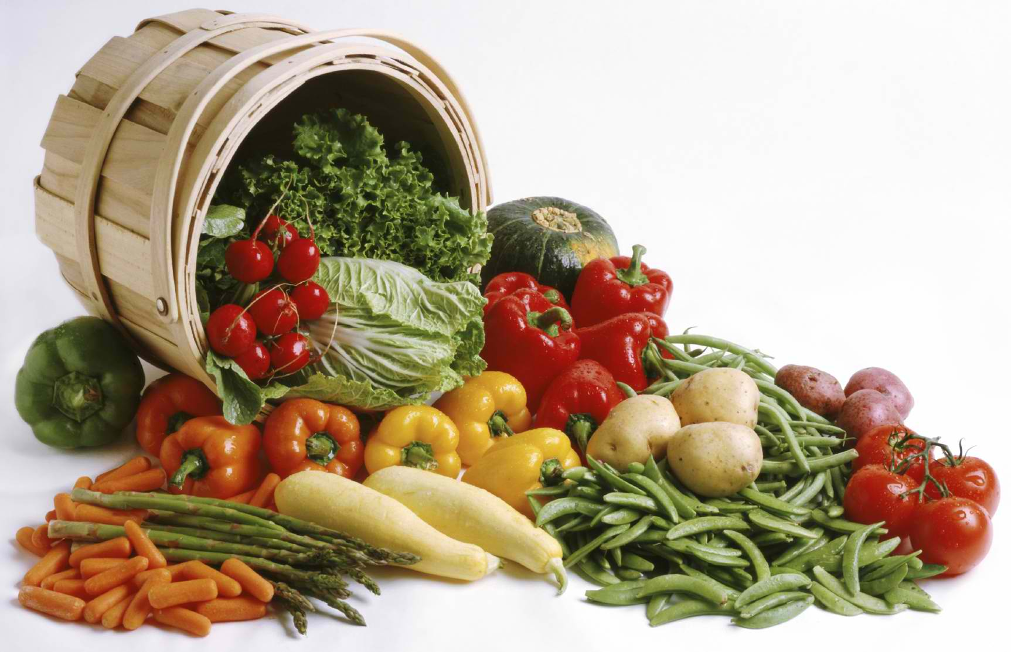
Let’s Talk Vegetables

Slide 15
Bush Beans
Seed Depth: 1”
Days to Germinate 7-10
Date to sow outdoors: April-June 20
Rotation: Follow corn
Spacing: 4”
Companions: Basil, marigold & strawberries
Varieties
  Bush Kentucky Wonder
  Contender
  Goldencrop Wax
  Harvester
  Resistant Cherokee Wax
  Tendercrop

Slide 16
Bush Beans
Sowing
    Do not plant in cold soil it slows germination
    Make several small plantings about 10 days apart so that you can have a continuous harvest.
Fertilize young plants with fish emulsion every 2 weeks for the first 6 weeks, then once every 3 to 4 weeks
Harvest when pods are as thick as a pencil

Slide 17
Broccoli
Seed Depth: ¼”
Days to germinate: 4-7
Sow Indoors: 4-6 wks before last frost
Outdoors: March1 and July 15
Rotation: Avoid cole crops (cabbage, cauliflower)
Spacing: 15” staggered rows
Companion: Bush bean, carrot, cucumber, lettuce, onion, spinach and tomatoes
Varieties:
  Bravo
  Green Comet
  Green Duke
  Packman
  Premium Crop
  Purple Sprouting
  Waltham 29

Slide 18
Broccoli
Transplants well, but be sure not to disturb roots
Set plants 1” deeper than they grew in the pots
Fertilize every 3 to 4 weeks with an organic fertilize such as fish emulsion
Harvest when the head is dark green and fully formed. The buds should be tight.
    Yellow buds is a sign the head is overripe
    Harvest by cutting the head free of the stalk with a knife
    Smaller heads will form as side shoots. Harvest every few days to keep more forming.

Slide 19
Cabbage
Seed Depth: ¼”
Days to germinate: 5-8
Sow Indoors:4-6 wks before last frost
Outdoors: Feb. 20-April 1 & July 1-July30
Rotation: Avoid cole crops
Spacing: 12-18”
Companions: Bush bean, carrot, tomatoes, cucumber, lettuce, onion, spinach
Varieties
  Charmont
  Danish Roundhead
  Early Jersey
  Wakefield
  King Cole
  Round Dutch
  Stonehead

Slide 20
Cabbage
Do not disturb root ball when transplanting
They are heavy feeders and need ample even supplies of most nutrients.
Mulch . It has a shallow root and are easily damaged from cultivation to fluctuations in soil moisture.
Harvest anytime after the head is the size of a softball.

Slide 21
Carrots
Seed Depth: ¼ - ½”
Days to Germinate: 6-8
Sow Outdoors: March 1 – April 1
Rotation: Avoid rotating with dill, fennel or parsley
Spacing: 2-3” apart
Companion: Onion, tomatoes, lettuce, rosemary, beans & sage
Varieties
  Soil that is difficult to work
      Danvers
      Little Finger
      Short n Sweet
      Thumbelina
  Deeper soils or raised beds
      Chanteney
      Nantes

Slide 22
Carrots
Plant in rows and thin out
Prefers roots to be cool; add a layer of mulch
Harvest by pulling them from the ground by their tops.

Slide 23
Cauliflower
Seed Depth: ¼”
Days to germinate: 6
Sow Indoors: 4-6 wks before last frost
Outdoors: March 1- April 1 & July 15- August 15
Rotation: Avoid cole crops & plant after beans
Spacing: 15” staggered rows
Companions: Bush bean, carrot, cucumber, lettuce, spinach & tomatoes
Varieties
  Andes
  Early White
  Imperial
  Snow Ball
  Snow Crown
  Snow King
  Violet Queen Hybrid

Slide 24
Cauliflower
When transplanting do not damage roots
Keep plants evenly watered
It is a heavy feeder and likes frequent watering with compost tea or dilute solutions of fish emulsion
Blanching is a technique used for the white varieties.
  When head is 2-3” fold leaves over the head and secure with a rubber band or twine.
  Improves flavor and texture
Harvesting
  In warm weather, harvest heads after 4 days of being tied
  In cooler weather harvest after 10 days
  Heads should be tight & fairly regular in shape

Slide 25
Corn, Sweet
Seed Depth: 1”
Days to Germinate: 4
Sow Outdoors: 1 wk after frost
Rotation: Plant after peas or beans
Spacing: 8”
Companions: Sunflowers, legumes, potato, parsley, carrots
Varieties
  Golden Cross Bantam
  Honey & Cream
  Jubilee
  Peaches & Cream
  Pearl White
  Silver Queen
  Sundance

Slide 26
Corn, Sweet
Prepare corn bed in fall
  Apply at least 1” of compost or rotted manure and work into the soil
To ensure good pollination plant each variety in blocks of 4 short rows rather than in a single row
Sow new blocks every 2 weeks to lengthen the season
Heavy feeder of nitrogen. Water regularly and fertilize every 2 weeks with a complete organic fertilizer such as fish emulsion
Harvest when you feel the husk to see if seems full and rounded and when the greenish silk turns brown at the very ends.

Slide 27
Cucumber
Seed Depth: ½-1”
Days to Germinate: 3-4
Sow Indoors: 3 wks before last frost
Outdoors: After last frost
Rotation: Avoid following gourd family
Spacing: 18” trellised or 36” mounds
Companions: Radish & marigolds
Varieties
  Pickle
    Bush Pickle
    Calypso
  Bush Slicing
    Bush Crop
    Fanfare
    Salad Bush
  Slicing Vine
    Burpless
    Marketmore
    SliceMaster
    Straight 8

Slide 28
Cucumber
Apply 1” of compost to the bed before planting and work it into the top few inches of soil
Cucumbers do not like to be transplanted. Sow directly in garden.
Fertilize every 2 weeks.
Once flowers appear make sure to maintain even soil moisture or misshapen, poor tasting fruits will result.
Harvest whenever they are large enough to use

Slide 29
Eggplant
Seed Depth: ¼”
Days to germinate: 7
Sow Indoors: 4-6 wks before last frost
Outdoors: Not recommended
Rotation: Do not follow tomato; follow bean or pea
Spacing: 18”
Companion: Basil, marigolds, bush bean, pea, pepper
Varieties
  Black Beauty
  Burpee Hybrid
  Easter Egg
  Little Finger
  Ichiban

Slide 30
Eggplant
Dislikes being transplanted.
Cover with a row cover and mulch to protect from insect damage.
Harvest plants after they’ve reached half their mature size.

Slide 31
Garlic
Clove Depth: 2”
Sow Outdoors: Later summer to fall
Rotation: Do not follow onion, cole crops or legume
Spacing: 6”
Companion: Carrots, cole crops
Varieties
  Bogatyr
  Georgian Crystal
  German Extra Hardy
  New York White

Slide 32
Garlic
Plant cloves in fall and mulch to protect the bulbs
Remove mulch in early spring and spread some compost on the bed
Once plants are up use shallow cultivation to keep the weeds under control
Harvest in late summer when the bottom 2 or 3 leaves have turned yellow or the tops fall over
Be sure the cure the bulbs.
    Spread plants on a screen and cure in full sun for 2 weeks or when the skins are dry and the necks are tight.
    Cover or move if it rains

Slide 33
Lettuce
Seed Depth: ¼ - ½”
Days to Germinate: 7-14
Sow Indoors: 4 wks before transplanting
Outdoors: when soil can be worked, throughout cool season
Rotation: Avoid other leaf lettuce & cabbage
Spacing: Leaf ½”, Head Lettuce 8-12”
Companion: Radish, strawberry, broccoli, bush beans, carrots, cucumber
Varieties
  Heading
    Great Lakes
    Itchaca
    Speckled
    Summertime
    Tennis Ball
  Green Leaf
    Black-seeded Simpson
    Grand Rapids
    Oak Leaf
  Romaine
    Green Towers
    Parris Island Cos
    Sangria

Slide 34
Lettuce
Seeds need light to germinate so sow them on top of the soil and cover very lightly with soil
Keep bed evenly moist
Grows best in cool weather
Add plenty of compost before planting and again as a sidedressing a week or so after seedlings appear.
Give supplemental feedings of compost tea every 2 weeks until harvest

Slide 35
Onions
Seed Depth: 1” for sets & ¼- ½” for seeds
Days to germinate: 4-5
Sow Indoors: 2 mths before last frost
Outdoors: February to March
Rotation: Avoid parsley & legumes
Spacing: 400-600 per 100 ft row
Companion: Carrots, cole crops
Varieties
  Ebenezer
  Red Baron
  Southport White Globe
  Chrystal White Wax
  Red Creole
  Red Wethersfield
  Texas 1015

Slide 36
Onions
Before planting turn in good amounts of compost or well rotted manure
Doesn’t compete well with weeds and are easily damaged.
Mulch to maintain moisture
Sidedress with compost during late spring
Ready to harvest when most of the tops fall over
Leave them to cure in the sun for at least a week

Slide 37
Peppers
Seed Depth: ¼”
Days to Germinate: 6-8
Date to sow indoors: 6 wks before last frost
Spacing: 12”
Rotation: Do not follow potato, eggplant or tomato
Varieties:
  Hot Peppers
    Anaheim
    Cayenne
    Habenero
    Jalapeno
  Sweet Peppers
    Ace
    Apple
    California Wonder
    Gypsy
    Bell Boy
    Golden Summer
    Hungarian Sweet Banana

Slide 38
Peppers
Peppers love heat. Wait until soil temperatures are 70-85 degrees
“Peppers like to hold hands”
  Plant close enough so the leaves of the mature plants are barely touching
Harvest so that it can set new fruits

Slide 39
Summer Squash
Seed Depth: ½-1”
Days to Germinate: 6-10
Date to sow indoors: 3-4 wks before frost
Date to sow outdoors:When soil temp reaches 70deg
Spacing: 12-18” mounds
Rotation: Avoid squash, pumpkin, melon, cucumber & watermelon
Varieties
  Patty Pan
    Peter Pan
    Scallopini
  Yellow
    Crookneck
    Early Yellow Summer
    Dixie
  Zucchini
    Aristocrate
    Black Zucchini
    Chefini
    Gold Rush

Slide 40
Summer Squash
Direct sow when soil reaches 70 degrees
Sow 3 seeds to a hill and space hills 18” apart and thin to 1 plant per hill when one true leaf is seen
Fertilize with fish emulsion. Do not over fertilize since it can limit yields.
Harvest when young and small and harvest often.

Slide 41
Tomatoes
Seed Depth: ½”
Days to germinate: 6-8
Date to sow indoors: 6-7 wks before last frost
Date to sow outdoors: After last frost
Spacing:15” supported bush, 17” unsupported & determinate, 36” unsupported and indeterminate
Rotation: Avoid potato, pepper, eggplant & tomatoes
Varieties:
  Disease Resistant Varieties
    Beefmaster
    Better Boy
    Big Boy
    Celebrity
    Early Girl
    Enchantment
    Lemon Boy
    Mountain Gold Romas
    Supersteak
    Supersweet

Slide 42
Tomatoes
Planting
    Dig a hole a least 6” in diameter and deep enough so that only about 4” of the plant will be above the soil
    Set plant in hole and fill with soil and firm.
    Water well with a dilute solution of fish emulsion or compost tea.
Fertilize every 2 to 3 weeks with the compost tea or fish emulsion
Mulch to keep weeds down and keep soil moist

Slide 43
How to Read a Seed Packet

Slide 44
Big Beef (F1): 73 Days
(V,FF,N,T,As,L)
A beefsteak-type tomato with meaty, tasty fruit and an old time tomato flavor. Early maturity and superior disease tolerance. Large (avg. 8-10oz), mostly blemish-free globe-shaped red fruit. Produces well, even under adverse conditions. Indeterminate.
Pkt $2.20; 1/16 oz. $9.90

Slide 45
Big Beef (F1): 73 Days
(F1): F1 versus OP
F1 is when 2 genetically dissimilar but related plants are crossed. F1 hybrid seed produces vigorous, high yielding plants. The downside to this is that it lasts for only 1 generation.
OP means it is open pollinated. The seed collected from these plants will produce offspring the same as its parents. Heirloom varieties are open pollinate.

Slide 46
Big Beef (F1): 73 days
Days to Maturity lets you know how long it takes from sowing the seed to harvesting the vegetable.
Remember the date is an educated guess. Some factors that can effect the date is type of growing season and soil fertility.

Slide 47
Big Beef (F1): 73 days
(V,FF,N,T,)
Diseases Resistance. Each catalog provides a key to the disease-resistant qualities each plant/seed has.
V=Verticillium Wilt Disease
FF=Fusarium Wilt
N=Root-Knot Nematodes
T=Tobacco Mosaic Virus

Slide 48
Big Beef (F1): 73 days
(V,FF,N,T,As,L)
A beefsteak type tomato with meaty, tasty fruit and an old time tomato flavor.
Description.

Slide 49
Big Beef (F1): 73 days
(V,FF,N,T,As,L)
A big beefsteak type tomato with meaty, tasty fruit and an old time tomato flavor. Early maturity and superior disease tolerance. Large (avg. 8-10 oz)
Vegetable size.

Slide 50
Big Beef (F1): 73 days
(V,FF,N,T,As,L)
A beefsteak type tomato with meaty, tasty fruit and an old time tomato flavor. Early maturity and superior disease tolerance. Large (avg. 8-10)oz. Mostly blemish free globe shaped red fruit. Produces well, even under adverse conditions.
Weather tolerance. This may include frost tolerance or resistance to bolting in hot weather.

Slide 51
Fertilization
Vegetable gardens require a “complete” fertilizer such as 6-12-12, 10-10-10, 13-13-13 or 15-15-15
  The first number is the percentage of nitrogen
    Promotes leaves and vegetation
  The second & third is phosphate & potassium
    Phosphate promotes roots
    Potassium promotes flowering and fruiting
Manure can be used as a supplement to the chemical fertilizer
Apply fertilizer in the spring before planting and work into the soil

Slide 52
Now You are Ready to Plant

Slide 53
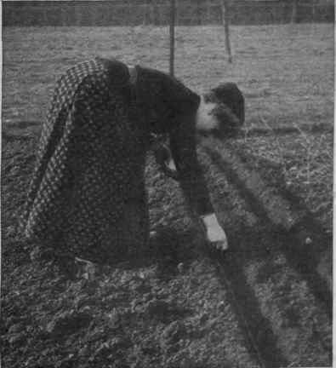
Seed Sowing
Make sure that the seedbed is smooth and level
    Makes it easier to place seeds at same depth
    Remove pebbles or large bits of soil
Make a furrow to the depth needed.
After sowing fill the furrow and gently pat the soil to make sure it makes contact with the seed.
Label the row
Water the bed very gently and evenly. Check the moisture daily and water when necessary.
  Remember the bed needs to be moist, but not soggy.

Slide 54
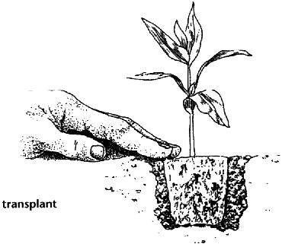
Planting with
Transplants
A week before you decide to plant prepare your bed and add any soil amendments. This will give the soil time to settle.
On planting day water your transplants thoroughly and let them stand for about an hour.
Make sure the bed is smooth. Remove any stones, sticks or other debris.
Remove the seedling from its container
Make a hole about 1 ½ times the size of the root ball
Gently put the transplant into the hole and firm the soil around the base of the plant, but don’t pack it.
Water it in.

Slide 55
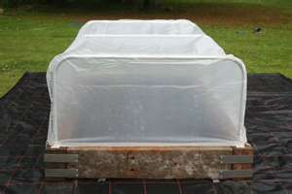
Protective Covers
Protects from cold weather and can extend growing seasons
Encourages plants to grow faster & produce early
What can be used?
  For individual plants
    Buckets
    Old blankets
    Milk jugs
      Cut out the bottom and remove cap and push into the ground
  For several rows of plants
    Spun bonded or plastic floating row covers
      Should be removed once plants have flowers so that pollination can happen
Covers must be removed once the temperatures moderate

Slide 56
Watering
Irrigation
  Best to irrigate with soaker hose or drip irrigation
  If using overhead sprinkler system only 1 to 1.5” of water should be applied at one time
    Let the water soak in for several days to a week before watering again
    Less likely to increase plant diseases
    Plants will be less dependent on frequent watering

Slide 57
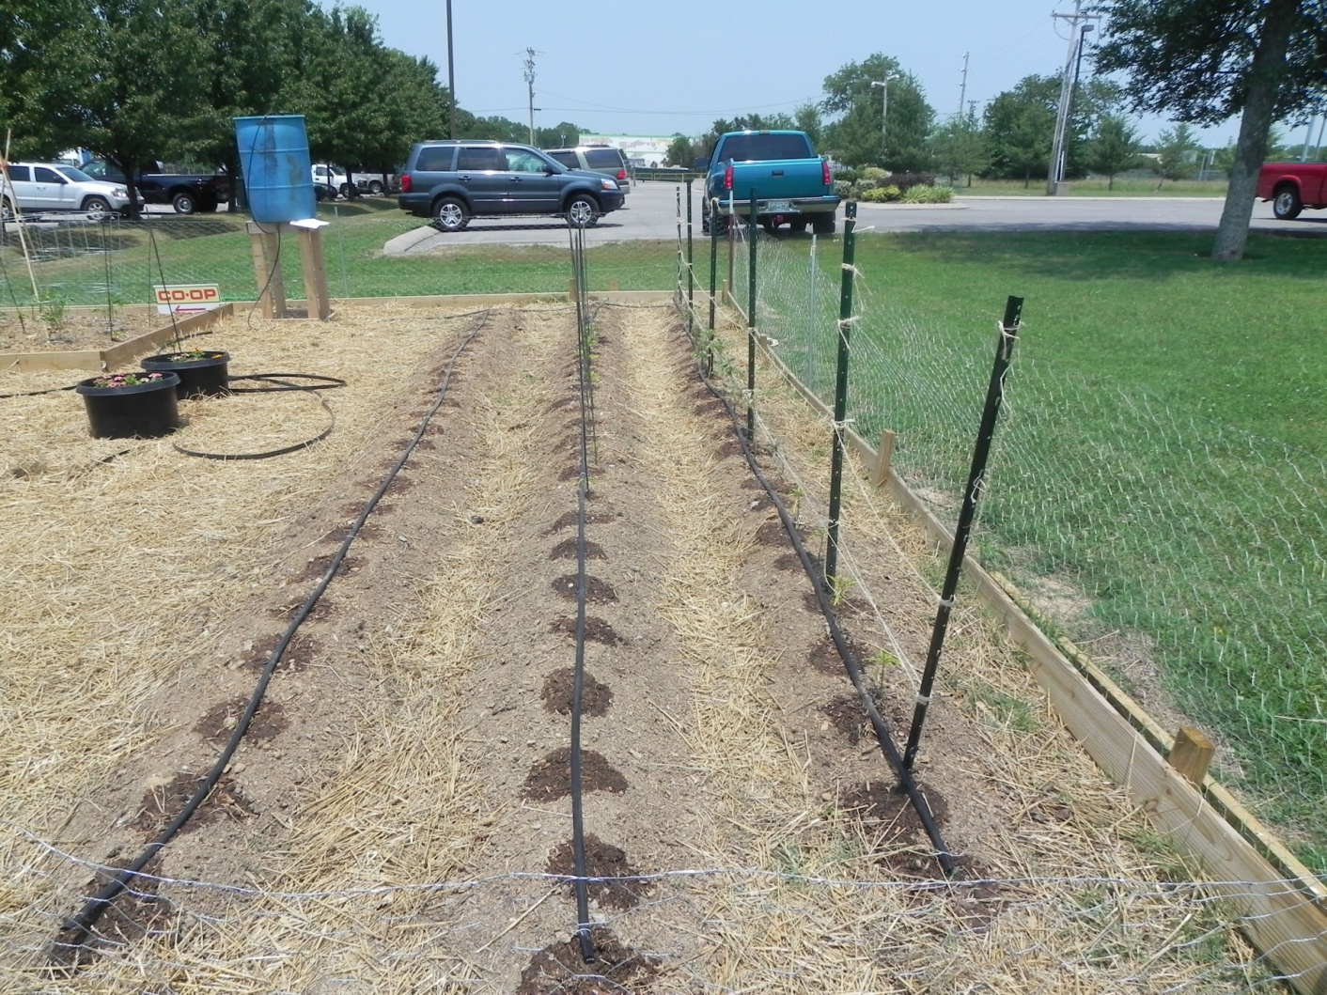
Something to Consider
Gravity Drip Irrigation System

Slide 58
Why??
Uses water efficiently/not wasted
Water is given directly to the roots
Help reduce standing water on foliage, reduces disease
Saves you time-can fill bucket- walk away
Fertigation!

Slide 59
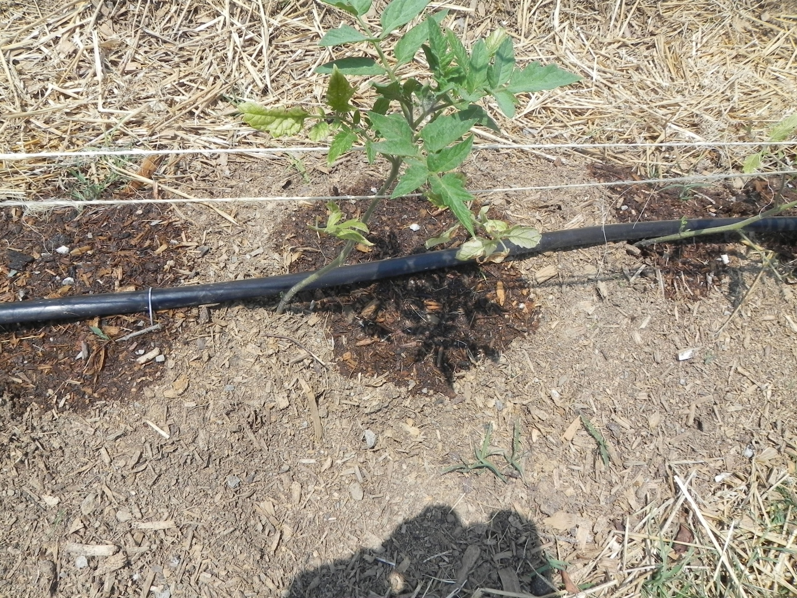

Slide 60
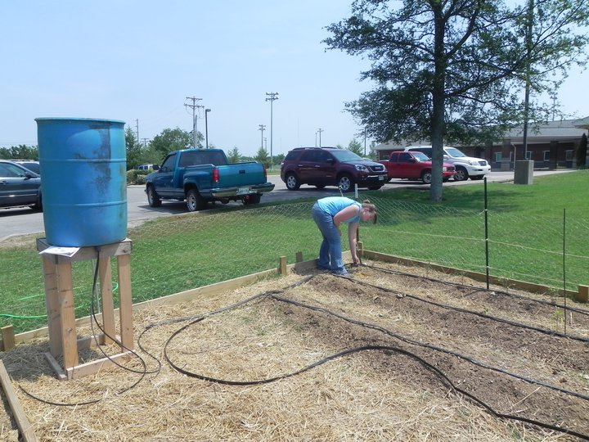
Elevated Pedestal
Drip Tape
Supply Lines
Header Tape

Slide 61
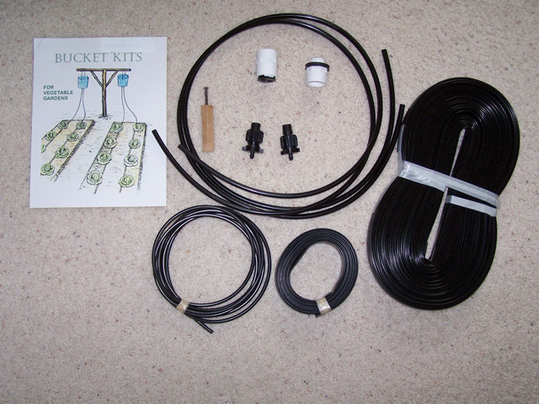
www.chapinlivingwaters.org

Slide 62
Plan Your Garden Accordingly
When first installed, run 2-3 times to create a wet spot on ground and cater your plant spacing to where there is a drip outlet
5 gallon bucket 40” above soil level can provide enough pressure to irrigate two rows of 50 ft. in length
Can also be used for four rows at 25 ft. in length or 6 rows at 12.5 ft. in length

Slide 63
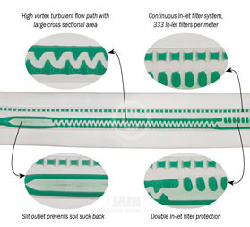
Remember
Drip tape should be installed with the outlets facing up to allow foreign particles to filter to the bottom of the line where they can be flushed out the end

Slide 64
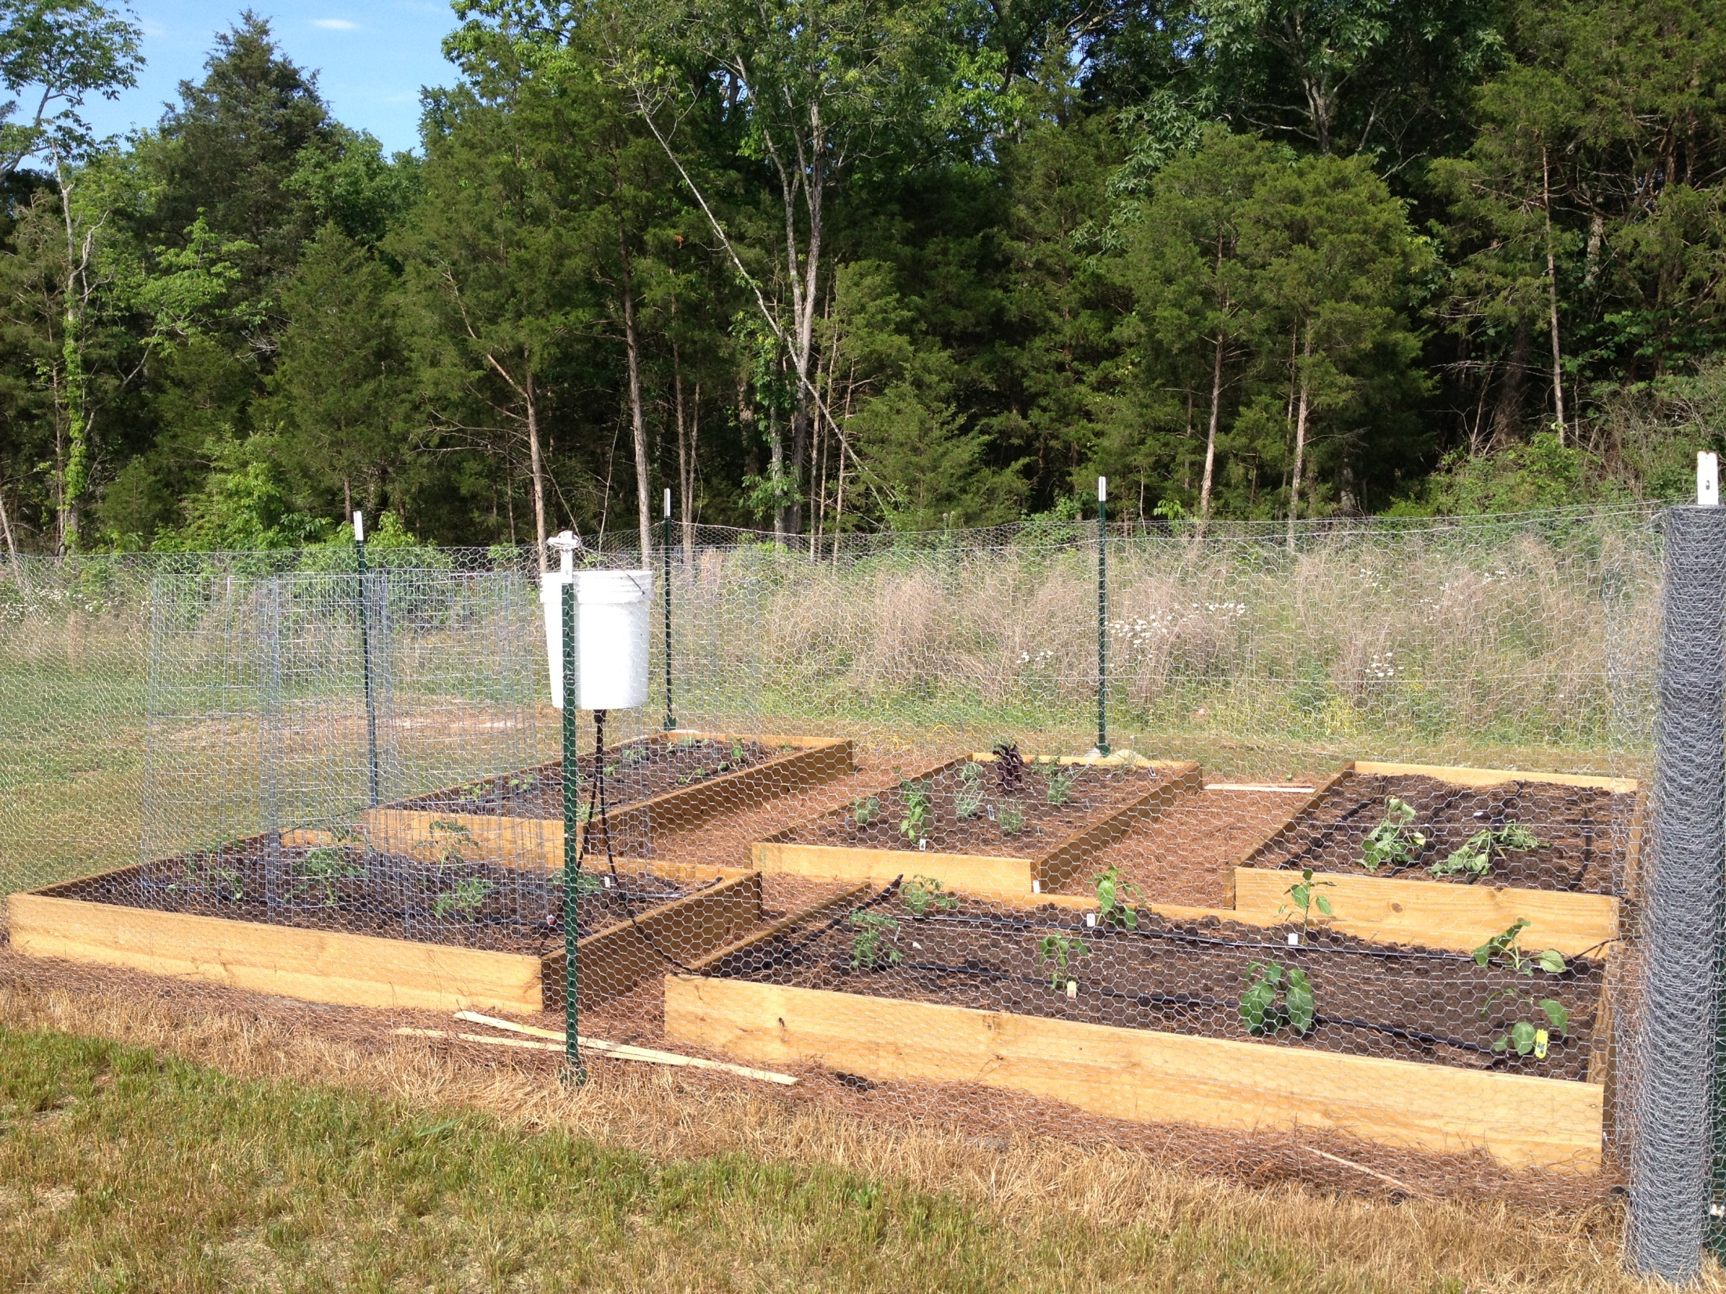

Slide 65
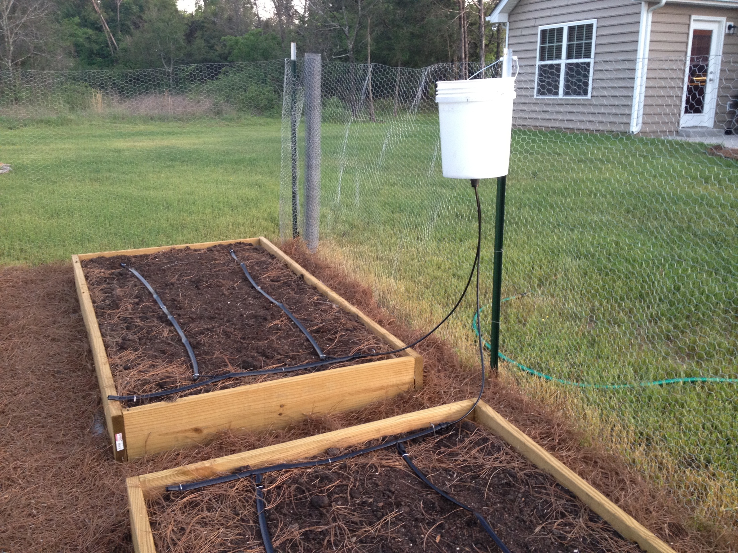

Slide 66
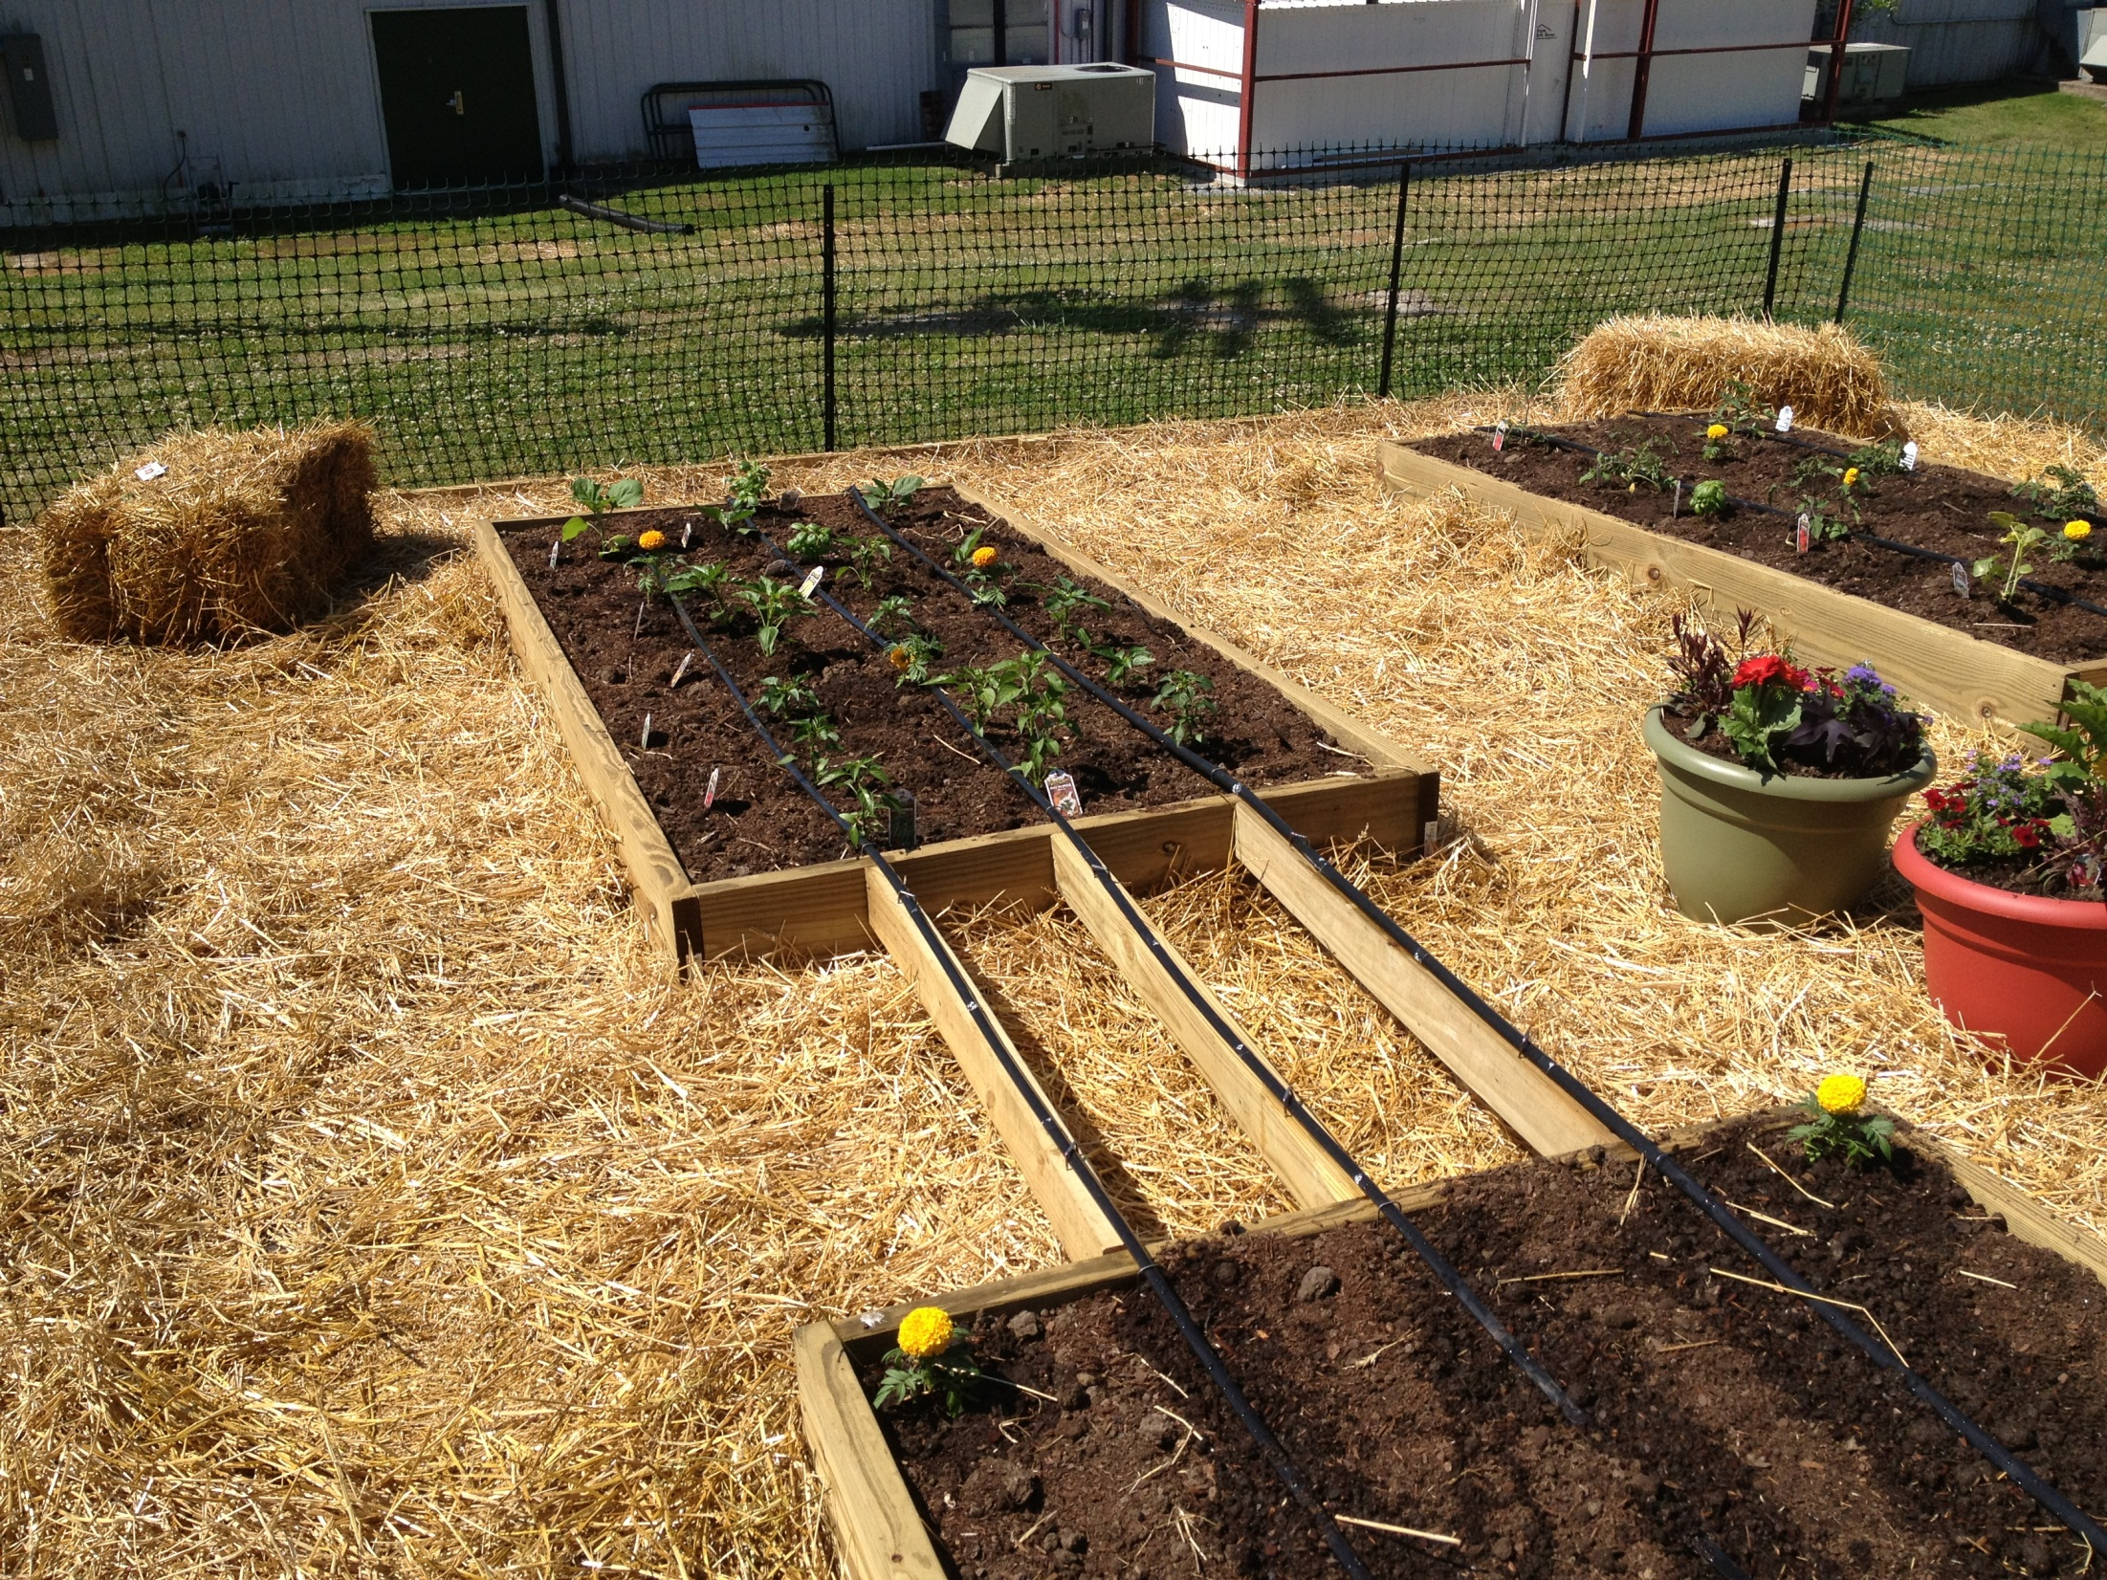

Slide 67
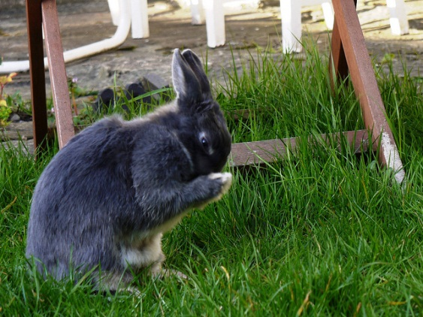
Pest Management
Common methods of control
  Companion Planting
  Intercropping
  Timing Planting
  Mulches
  Pesticide
  Natural protective substances

Slide 68
Pest Management
Companion Planting
Plants that assist each other to grow well
      Peas & beans help corn by restoring to the soil nitrogen that the corn used up
Plants that repel insects
      Onions, leeks, rosemary and sage repel the carrot fly, whose maggot or larva attacks the rootlets of carrots
Plants that repel other plants
      Fennel has inhibiting effect on bush beans and tomatoes

Slide 69
Pest Management
Intercropping
Raising two or more crops in the same area at the same time
Insects are deterred because they recognize large area of single vegetables instead of crops that are interplanted
Plant light feeders, like carrots, with heavy feeders, like tomatoes
Match deep rooted plants, like parsnip, with shallow rooted plants, like onion.
Plants that prefer cooler temperatures, like lettuce, can benefit from the partial shade of tall companions, like pole beans.

Slide 70
Pest Management
Conventional Controls
Pesticides
  Not selective
  Will eliminate your beneficial insects such as bees
Use non-chemical means of insect control
  Sanitation
  Barriers
  Repellents
  Traps & baits
  Encourage beneficial insects and birds
  Remove insects by hand
Use the least toxic recommended control measure
  Insecticidal soaps
  Bt

Slide 71
Pest Management
Weeds
Weeds compete with vegetable plants for water, nutrients and sunlight
Weeds serve as a refuge for insects
Control
  Prevent weeds to develop mature seeds
  Easiest to remove when they are small
  Hoe or till frequently, but shallowly so not to cut vegetables roots
  Use mulches
Herbicides
  Are not recommended to home vegetable gardeners
    Difficult to use
    Not effective
    Uniform application is difficult
    Expensive

Slide 72
Pest Management
Mulching
2 to 3” layer of organic mulch can
  Conserve water
  Regulate soil temperature
  Suppress weeds
  Provides organic material as it breaks down
Examples of organic mulch are
  Finely shredded or chipped hardwood bark
  Compost
  Pine Straw
  Newspaper

Slide 73
Pest Management
Disease Control
Begin control with sanitation
Remove insect or disease infested plant residues from the garden plot
Do not save seed from diseased plants
Support tall-growing, non-supporting vegetables such as tomatoes and cucumbers
Space rows and plants within rows for the air to flow freely
Time plantings to avoid the worst pest problems whenever possible
Rotate crops
Grow disease resistant varieties
Frequent observation of the garden

Slide 74
REFERENCES
Utextension.tennessee.edu/publications
The Vegetable Gardener’s Bible
    Edward C. Smith
The Organic Gardener’s Handbook of Natural Insect and Disease Control
    Edited by Barbara W. Ellis and Fern Marshall Bradley
wcmastergardener.org

Slide 75
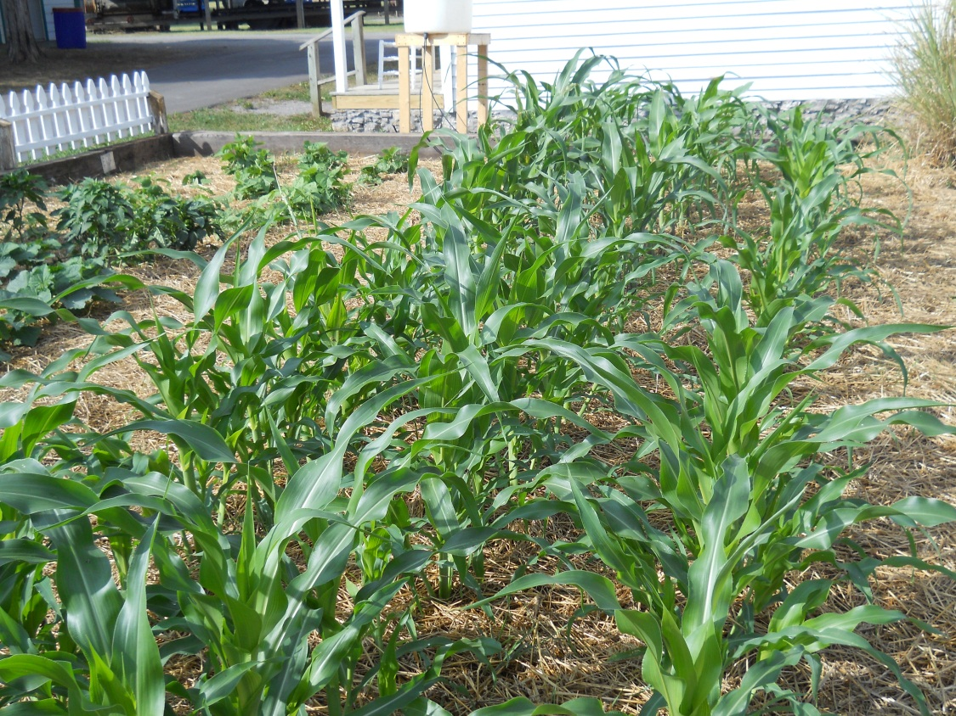
QUESTIONS

