Slide 1

Compost 101
Anna Duncan

Slide 2
How much worm food do we throw away every day?

Slide 3
Objectives
Become more aware of the value of household “waste”.
Define compost.
Understand what can and cannot be added to a compost pile.
Be able to start a compost pile.

Slide 4
What is compost?
Noun- a mixture that consists largely of decayed organic matter and is used for fertilizing and conditioning land
1
Verb- to convert (a material, such as plant debris) to compost
2
-Merriam-Webster Dictionary

Slide 5
Simple formula
“Waste”
Compost
Heat
Moisture
Oxygen

Slide 6
What can go in the compost?
In
Out
Leaves
Raw vegetable stems, leaves, and scraps
Fruit peels
Egg shells
Coffee grounds
Grass clippings
Cooking oil
Diseased plant material
Meat/ Dairy
Seeds
Animal Waste

Slide 7
Green vs brown
Provide Nitrogen
Provide Carbon
Food Scraps
Fresh Grass Clippings
Coffee Grounds
Dried Leaves
Tea Bags
Coffee Filters
Cardboard

Slide 8
Heat, Moisture, and Oxygen

Slide 9
But, why?
?

Slide 10
Better soils & less waste
Improved Drainage
Improved Soil Texture
Added Nutrients
Less Waste in Landfills

Slide 11
Compost bins
Capacity
Turning
Sun Exposure

Slide 12
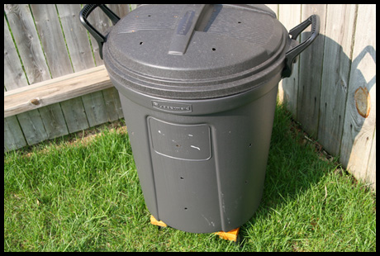
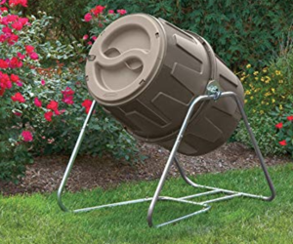
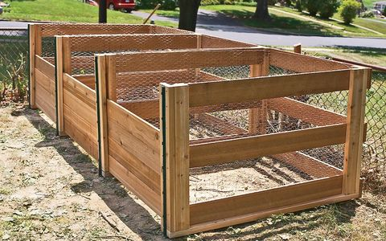

Slide 13
Get started!
Decide on a bin or pile style.
Start collecting “waste”.
Wait.

Slide 14
Thank you!

